Slide 1
INTELLIGENT SHOPPING EXPERIENCES: AI-DRIVEN INSIGHTS FOR PERSONALIZED RECOMMENDATIONS
Presented by:
T. Hemanth Babu (21JR1A05I3)
R. Niranjan (21JR1A05G8)
SK. Akram (21JR1A05H2)
V. Kiran Sai (21JR1A05J1)
Under the Guidance of
Dr. S. Radhakrishnan
Professor, Dept of CSE

Slide 2
Abstract
E-commerce platforms face challenges in delivering personalized product discovery and actionable insights, resulting in a fragmented user and seller experience.
This project addresses the issue by integrating AI and machine learning to create a platform that uses dynamic attribute-based tags and multi-algorithmic recommendations.
This project includes designing and testing a system that improves product categorization, enhances user engagement, and optimizes seller visibility.
Findings indicate that leveraging dynamic tagging and advanced algorithms significantly improves discoverability and satisfaction for both users and sellers.
The project concludes that AI-driven personalization is essential for a seamless, efficient, and engaging e-commerce experience.

Slide 3
Introduction
Traditional e-commerce platforms face challenges in delivering personalized shopping experiences and ensuring seamless product discoverability. Users often struggle to find products that match their preferences, leading to lower engagement.
This project aims to solve these issues by creating an AI-driven e-commerce platform that uses machine learning for personalized recommendations. It incorporates an attribute based tagging system for improved product categorization and discoverability.
Users interact with products by liking them, which allows the platform to collect insights and refine recommendations based on their interests. Sellers are provided with valuable analytics to enhance product and sales strategies.
The platform seeks to create a seamless, data-driven shopping experience that bridges the gap between user satisfaction and seller success, ensuring a more engaging and efficient e-commerce environment.

Slide 4
Literature review
Jayakrishnan (2021) – "Artificial Intelligence (AI) in Retailing: A Systematic Review and Research Agenda": The study explores the growing adoption of Artificial Intelligence (AI) and Machine Learning (ML) in retail, focusing on their applications in store management, inventory optimization, and personalized customer experiences. AI’s ability to analyze large datasets and improve decision-making is transforming the retail industry. The research also identifies emerging areas for further exploration, particularly in light of the accelerated adoption of these technologies during the pandemic.
Nkomo & Mupa (2021) – "The Impact of Artificial Intelligence on Predictive Customer Behaviour Analytics in E-commerce: A Comparative Study of Traditional and AI-driven Models":
Nkomo and Mupa (2021) examine the impact of Artificial Intelligence (AI) on predictive customer behavior analytics in e-commerce, comparing AI-driven models with traditional approaches. The study finds that traditional models, like logistic regression and decision trees, face limitations in scalability, accuracy, and data processing. In contrast, AI-driven models, utilizing machine learning, deep learning, and natural language processing, excel at handling large datasets and delivering real-time predictions.

Slide 5
Kannan & Trilok Singh (2021) – "Transforming Retail with Artificial Intelligence: Analyzing the Impact of AI and Machine Learning on Consumer Experience in the UAE“
This study explores how AI and ML are revolutionizing the UAE retail sector by enhancing consumer experiences. Key areas of impact include personalization, inventory management, and predictive analytics. The integration of these technologies not only improves operational efficiency but also boosts customer satisfaction by offering more customized and engaging shopping experiences. The research provides valuable insights for retailers aiming to remain competitive in a rapidly evolving market.
Gupta et al. (2023) – "The Disruption of Retail Commerce by AI and ML: A Futuristic Perspective“
Gupta and colleagues present a systematic review of the transformative role of AI and ML in retail. The study emphasizes benefits such as personalized recommendations, efficient inventory management, and optimized supply chains. It also addresses challenges like ethical concerns and the need for responsible technology adoption. The paper offers a forward-looking analysis of AI and ML's disruptive potential, serving as a useful reference for both academic researchers and industry stakeholders.

Slide 6
The Integration of Artificial Intelligence Techniques in E-Commerce: Enhancing Online Shopping Experience and Personalization:
This study investigates the use of Artificial Intelligence (AI) techniques, such as machine learning, neural networks, and fuzzy logic, to improve the online shopping experience. Key focus areas include personalized recommendations, chatbots, and fraud detection. Case studies from Amazon and Alibaba demonstrate that AI enhances customer satisfaction, increases revenue, and reduces costs. However, challenges such as data privacy concerns, integration complexities, and high implementation costs persist, especially for smaller platforms. The research highlights the need for scalable AI solutions to ensure widespread adoption across the e-commerce industry.
Xu et al. (2024) – "Intelligent Classification and Personalized Recommendation of E-commerce Products Based on Machine Learning":
This study presents a personalized recommendation system for e-commerce platforms like eBay, utilizing the BERT model for semantic understanding and a nearest neighbor algorithm for precise product suggestions. The system addresses challenges like product overload by tailoring recommendations to user preferences. Results show improved user satisfaction, engagement, and conversion rates. However, challenges such as data privacy, integration with legacy systems, and expanding to multimodal data remain areas for future research.

Slide 7
Haque (2024) – "E-Commerce Product Recommendation System based on ML Algorithms":
This study introduces a machine learning-based model for personalizing product recommendations on e-commerce platforms. Using collaborative filtering and hybrid techniques, the system enhances user satisfaction and engagement by delivering tailored suggestions. The model effectively reduces search time and boosts conversion rates. However, challenges like data sparsity, scalability, and real-time processing remain. The research emphasizes addressing these issues for broader adoption. Future work involves optimizing the model for large datasets and evolving user behaviors.
Verma and Sharma (2020) – "Artificial Intelligence in Retailing":
This article presents a framework highlighting the use of artificial intelligence in retail, with a focus on marketing and machine learning applications. It explores AI-driven tools like chatbots, recommendation systems, and customer sentiment analysis, which enhance personalization and streamline operations. The study also examines how machine learning aids in demand forecasting and inventory optimization. Despite the benefits, challenges such as high implementation costs and data privacy concerns are discussed. The research emphasizes the need for scalable AI solutions tailored to small and medium-sized retailers. Future directions include integrating AI with emerging technologies like IoT and AR for immersive retail experiences.

Slide 8
Problem Identification
Lack of Personalization: Traditional e-commerce platforms often fail to offer tailored product recommendations, leading to a one-size-fits-all approach. Users are presented with generic suggestions that may not match their unique preferences, diminishing engagement and satisfaction.
Inefficient Product Discovery: On many e-commerce platforms, the product categorization is either too broad or poorly organized, making it difficult for users to find items that match their specific needs. This often results in frustration, as users have to sift through irrelevant products to find what they want.
Overwhelming Choices: With millions of products available, users are overwhelmed by the sheer volume of options. This information overload can cause decision fatigue, leading to abandoned carts and reduced conversion rates. A more intuitive discovery process is necessary to simplify decision-making.
Missed Opportunities for Sellers: Sellers often lack actionable insights into customer preferences, making it difficult for them to optimize their product listings or target the right audience. Without data-driven strategies, they miss opportunities to improve product visibility and increase sales.

Slide 9
User Engagement Issues: Many platforms fail to encourage meaningful interactions from users, such as liking or saving products. These interactions provide valuable data that can be used to refine recommendation engines and improve the shopping experience, ultimately leading to higher retention and conversion rates.
Inconsistent User Experience: Without personalization, the user experience remains static and impersonal, which can result in lower engagement and fewer repeat visits. A more tailored approach would make the shopping experience feel more relevant and rewarding to each user.
Difficulty in Categorization: Product categorization on existing platforms is often too basic or static, making it hard for users to find products that match their specific interests. A dynamic, attribute-based system could improve the discoverability of products by aligning them with users' unique preferences.
Seller Performance Challenges: Sellers typically do not have access to comprehensive analytics on customer behavior, making it difficult to track which products are performing well and why. This lack of insight hampers their ability to refine product offerings, adjust marketing strategies, and ultimately boost sales.

Slide 10
Proposed System
Personalized User Experience
Machine Learning Recommendations: The platform utilizes machine learning algorithms to offer personalized product recommendations based on user behavior, past interactions, and preferences. This ensures that users are consistently presented with relevant and engaging products.
User Interaction Data: Users can engage with products by liking or saving them, which helps the system understand their preferences better. This interaction feeds into the recommendation system, improving the accuracy of future product suggestions.
Advanced Product Categorization
Attribute-Based Tagging: Products are dynamically categorized using detailed attributes such as color, brand, size, and style. This allows users to search and discover products that closely align with their preferences.

Slide 11
Smart Search and Filters: The search engine is optimized to offer refined results based on user activity and historical preferences, ensuring users find relevant products quickly and effortlessly.
Seller Insights and Analytics
Data-Driven Performance: Sellers gain access to comprehensive analytics that provide insights into customer preferences and product performance. This helps them refine their offerings to better meet customer needs.
Real-Time Reporting: Sellers can monitor product engagement and sales trends in real-time, enabling them to adjust marketing strategies and optimize product listings based on up-to-date data.
Multi-Algorithmic Recommendation Engine
Collaborative Filtering: The platform uses collaborative filtering to recommend products based on the purchasing and browsing habits of similar users, improving the relevance of suggestions.

Slide 12
Content-Based Filtering: By analyzing product attributes and user interests, content-based filtering ensures that the recommendations are tailored to the user's previous behaviors and preferences, offering a more personalized experience.
Seamless Shopping Experience
Intuitive User Interface: The platform is designed with an intuitive, easy-to-navigate interface that makes it simple for users to browse, shop, and interact with personalized content.
Responsive Design: The system is optimized for both mobile and desktop devices, ensuring a smooth and consistent shopping experience across different screen sizes and platforms.
Targeted Marketing and Promotions
Customized Advertising: Sellers can create highly targeted ads based on the data collected from user interactions. This allows them to focus their advertising efforts on segments of customers most likely to convert.
Behavioral Targeting: By analyzing user behavior and preferences, the platform delivers personalized promotions and offers that are relevant to individual customers, increasing the chances of a purchase.

Slide 13
Requirement Analysis
User Requirements
Personalized Shopping Experience: The system should cater to individual user preferences.
Efficient Product Discovery: Users should be able to find products easily.
Seamless Navigation: The system should be easy to move around in.
Functional Requirements
Personalized Recommendations: The system should suggest products to users.
Dynamic Product Categorization: The system should automatically organize products.
Real-Time Analytics for Sellers: The system should provide sellers with up-to-date information.
Non-Functional Requirements
Scalability and Performance: The system should be able to handle a large number of users and data, and it should be fast.
Data Privacy and Security: The system should protect user data.

Slide 14
Module Description
User Interaction Module
Tracks user actions (likes, saves, browsing, purchases).
Refines personalized recommendations
Front-end: Angular/React.js
Recommendation Engine Module
Uses ML for personalized suggestions.
Built with Python , integrated with back-end.
Product Categorization Module
Dynamic attribute-based tagging.
Enhances product discoverability & search efficiency.

Slide 15
Analytics Module
Real-time insights on user behavior, product performance & sales trends.
Helps sellers optimize strategies.
Seller Dashboard Module
Manages product listings & performance metrics.
Empowers sellers with data-driven decisions.
Search and Filter Module
Advanced search with filters by preferences & product attributes.
Uses Elasticsearchfor efficient search.
Security and Privacy Module
Ensures data privacy compliance & robust security measures.
Focused on data protection & regulatory adherence.

Slide 16
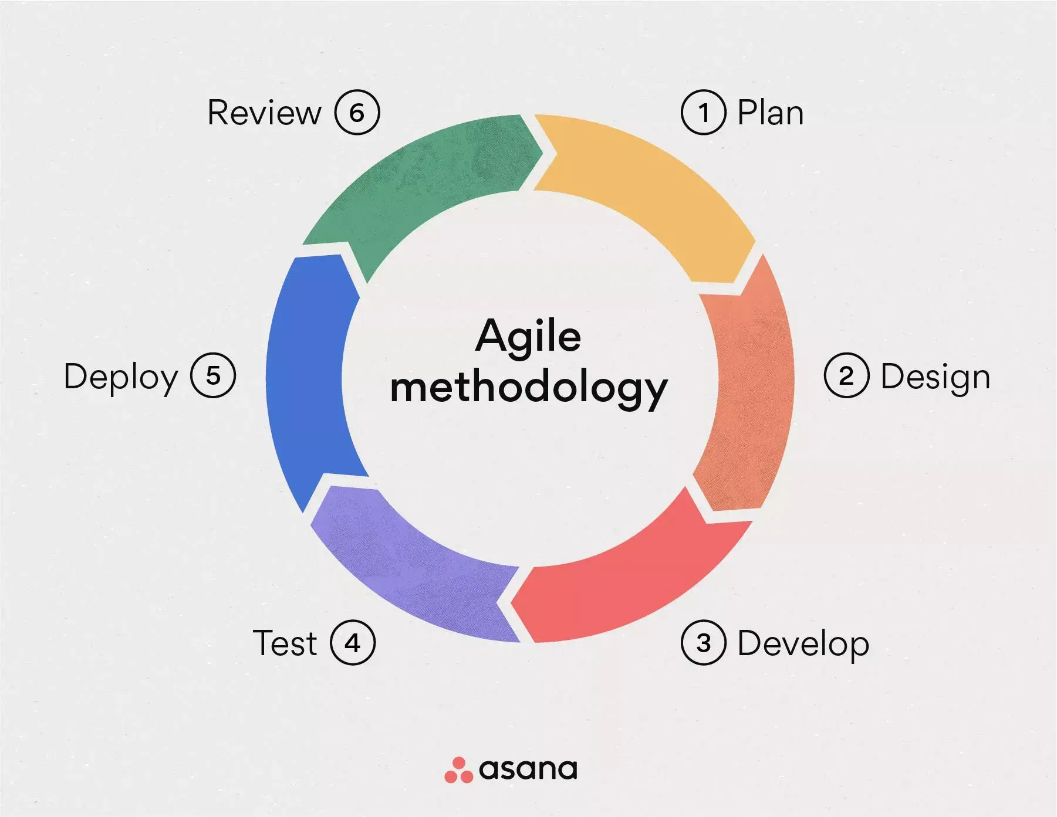
Process Model Used
Agile Model:
Agile is an iterative approach that delivers software in small, functional increments, ensuring continuous improvement.
It emphasizes collaboration, flexibility, and quick adaptation to changing requirements through regular feedback.
The focus is on delivering value early and often, ensuring faster time-to-market with high product quality.
Agile promotes cross-functional teamwork, empowering teams to self-organize and respond to challenges effectively.

Slide 17
Implementation Of Agile Model for Our Project
Plan Phase: Define features ,Analyze AI/ML frameworks, cloud feasibility, Identify risks, privacy, scalability, integration
Design Phase: System architecture & database schema, UI/UX wireframes & prototypes
Develop Phase: Iterative module development, RESTful API integration
Test Phase: Validate features ,Unit & integration testing with user/seller simulations
Deploy Phase: MVP launch, performance monitoring, automated deployment & updates
Review Phase: Feedback collection, optimization, Plan next iteration or full-scale deployment

Slide 18
Design Phase
Design Concepts:
• Personalized User Experience:
The platform uses machine learning algorithms to provide tailored product recommendations based on user behaviour, preferences, and past interactions, ensuring a highly personalized shopping experience.
• Dynamic Product Categorization:
Products are categorized using attribute-based tagging enabling efficient search and discovery of products that match user preferences.
• Multi-Algorithmic Recommendation Engine:
The platform combines collaborative filtering and content-based filtering to deliver accurate and relevant product suggestions, enhancing user engagement and satisfaction.

Slide 19
Design Constraints:
• Data Privacy and Security:
The platform must comply with data privacy regulations and implement robust security measures, such as encryption and secure authentication, to protect user and seller data.
• Scalability:
The system must handle large datasets and high user traffic efficiently, ensuring consistent performance even during peak usage times.
• Real-Time Processing:
The platform must provide real-time recommendations and analytics, requiring low-latency processing and high-performance infrastructure.
• Integration with Legacy Systems:
The platform must integrate seamlessly with existing e-commerce systems and databases, which may have varying architectures and technologies.

Slide 20
Logical Design
User Interaction: User browses products and interacts with the platform.
Data Processing:System analyses user behaviour and preferences.
Dynamic Categorization:Products are dynamically tagged for efficient discovery.
Real-Time Analytics :Seller’s gain insights into customer behaviour and product performance.
Personalized Recommendations :Users receive tailored product suggestions.
Order Processing :Users place orders and track their status.
Feedback and Improvement :System evolves based on user and seller feedback.

Slide 21
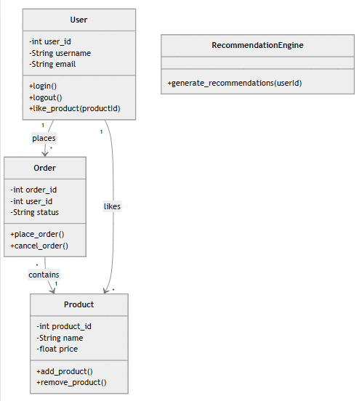
Class Diagram
A class diagram for the e-commerce platform, featuring User, Order, Product, and RecommendationEngine classes. The User class manages user details and actions like login and liking products. The Order class handles order placement and cancellation. The Product class stores product information and supports adding/removing items. The RecommendationEngine generates personalized suggestions for users. This structure ensures smooth interactions between users, orders, products, and recommendations, creating a cohesive e-commerce system.

Slide 22
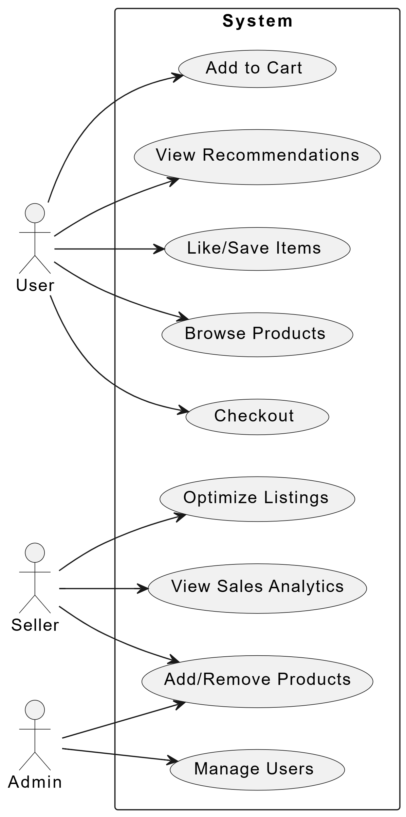
Use Case Diagram
The key functionalities of the AI-driven e-commerce platform, categorized by the roles of User, Seller, and Admin. For Users, the platform offers features such as browsing products, viewing personalized recommendations, liking/saving items, adding products to the cart, and proceeding to checkout. Sellers can optimize product listings, view sales analytics, and add/remove products to manage their inventory effectively. Admins have the ability to manage users, ensuring the platform operates smoothly and securely. This multi-role system ensures a comprehensive e-commerce experience, where users enjoy a personalized shopping journey, sellers gain actionable insights to grow their businesses, and admins maintain the platform’s integrity and functionality.

Slide 23
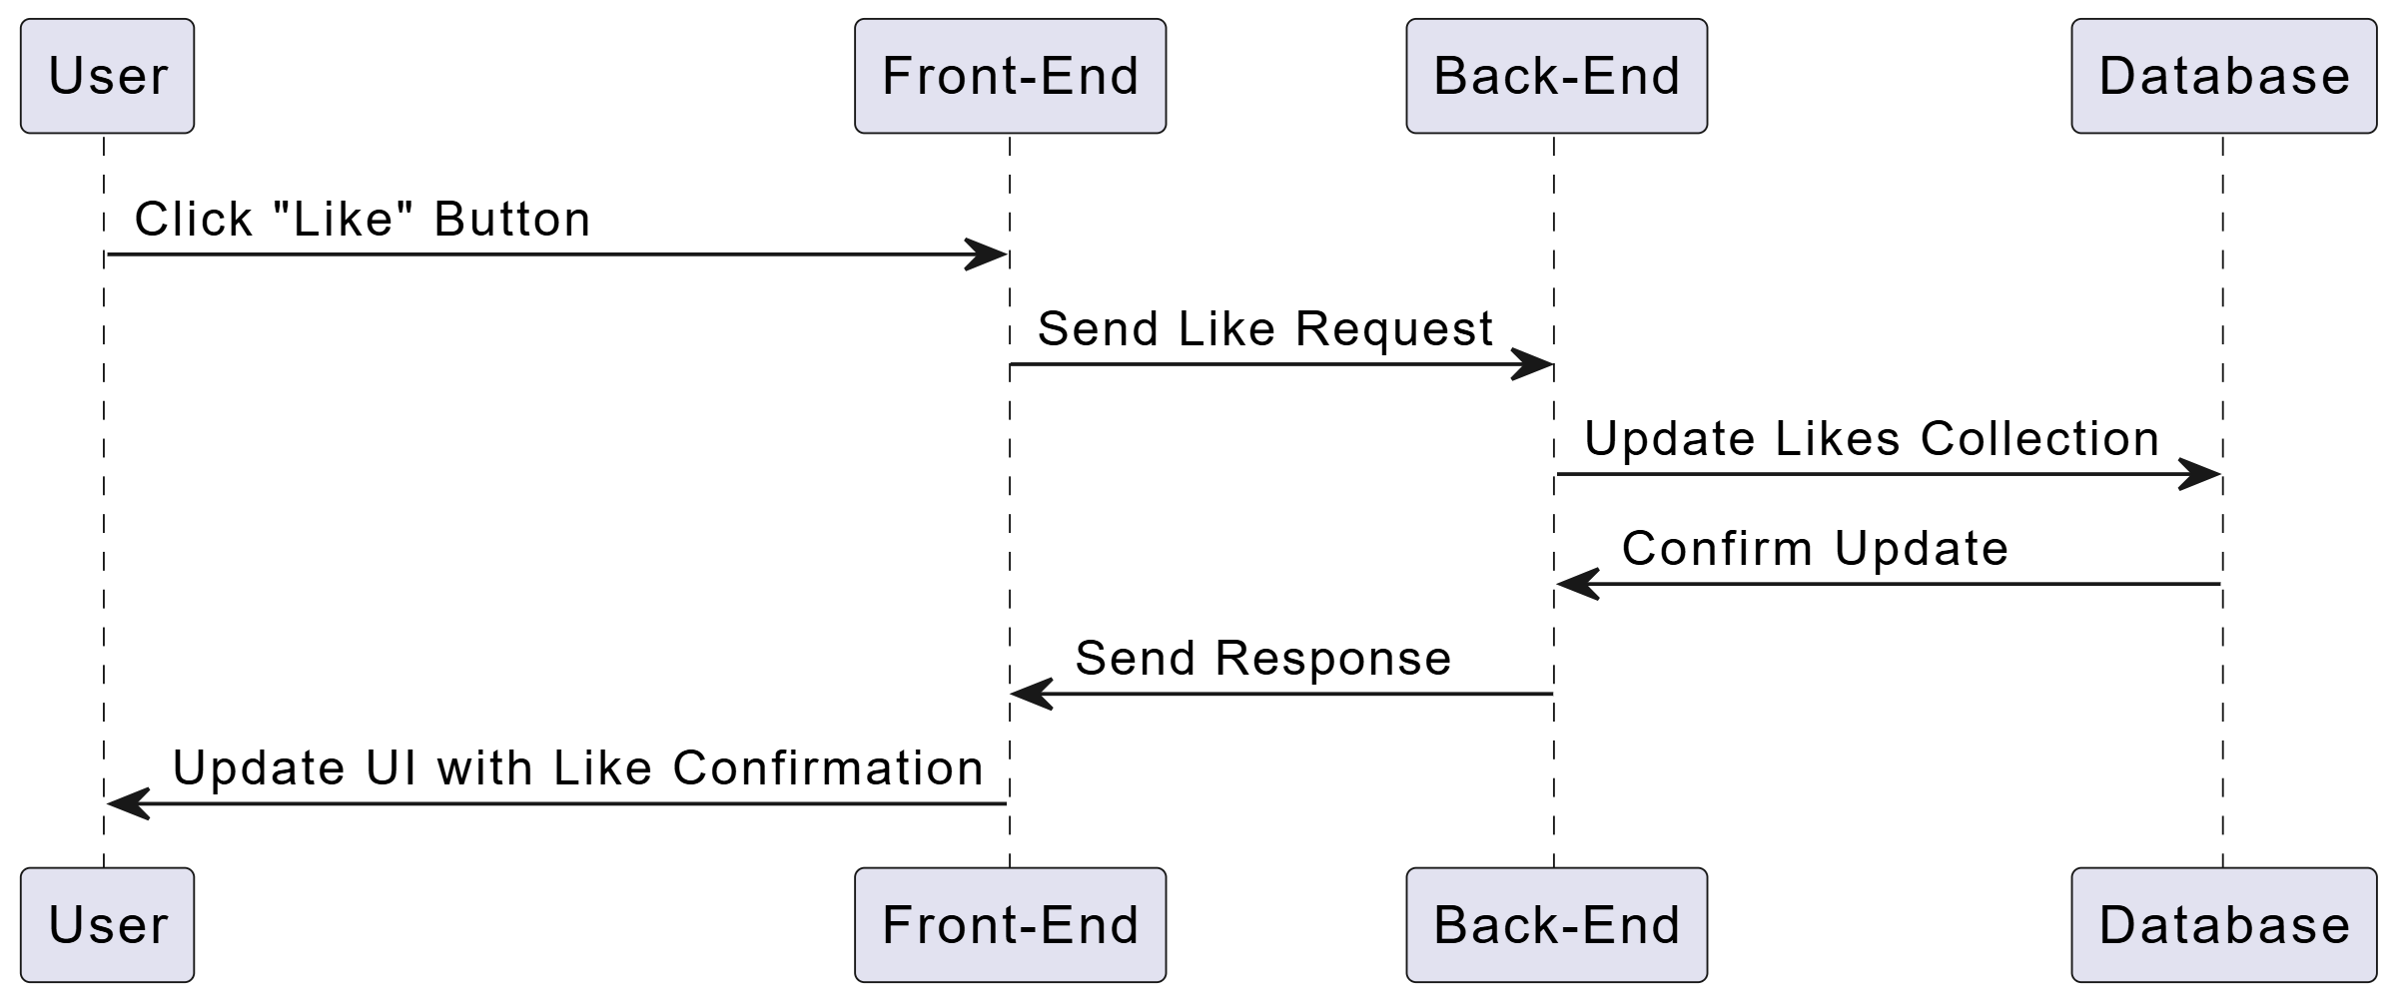
Sequence Diagram
The sequence of actions when a user clicks the "Like" button on the e-commerce platform. The Front-End sends a like request to the Back-End, which updates the Likes Collection in the Database. Once confirmed, the Back-End sends a response, and the Front-End updates the UI to reflect the like confirmation. This seamless interaction ensures a smooth user experience, with real-time updates and efficient data handling across the platform's layers.

Slide 24
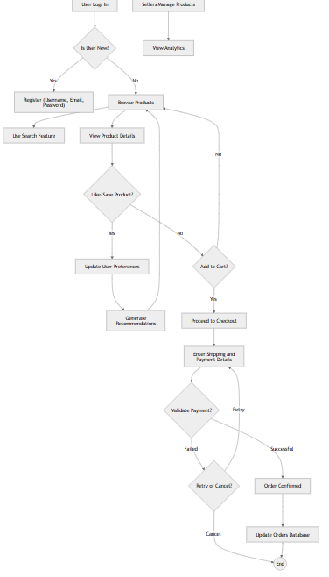
Activity Diagram
The Activity of the e-commerce platform, starting with browsing products, using search features, and viewing product details. Users can like products, update preferences, and add items to their cart. The process proceeds to checkout, where users enter payment details, validate the request, and confirm the order. The system updates the order database upon successful completion. This workflow ensures a seamless and intuitive shopping experience for users

Slide 25
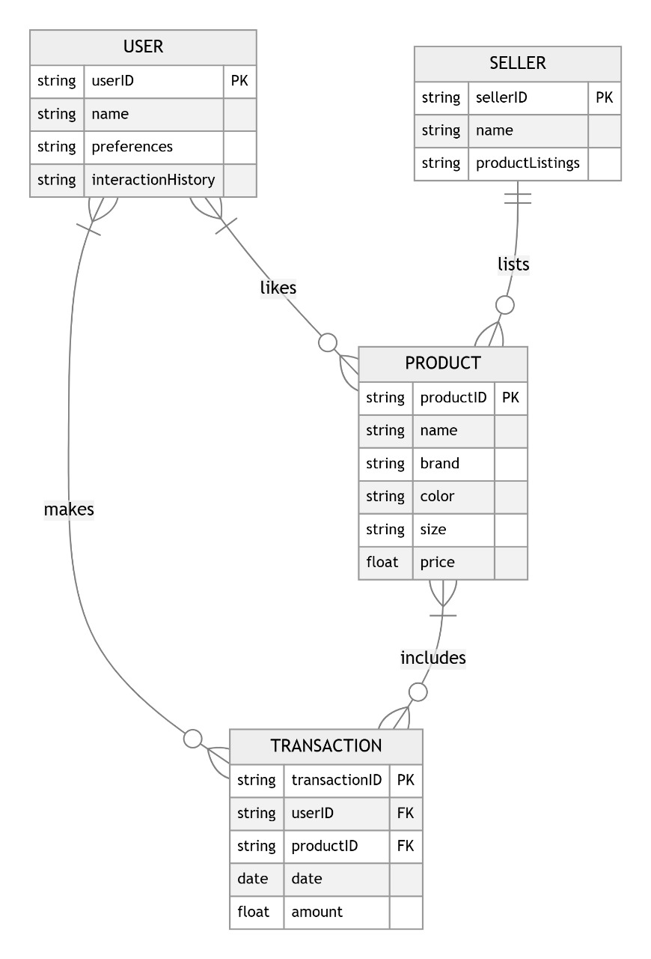
Entity Relationship Diagram
The ER for the e-commerce platform, featuring USER, SELLER, PRODUCT, and TRANSACTION tables. The USER table stores user details like ID, preferences, and interaction history. The SELLER table manages seller information and product listings. The PRODUCT table contains product details such as ID, name, brand, and price. The TRANSACTION table records purchase details, linking users and products. This schema ensures efficient data management and supports seamless interactions between users, sellers, products, and transactions.

Slide 26
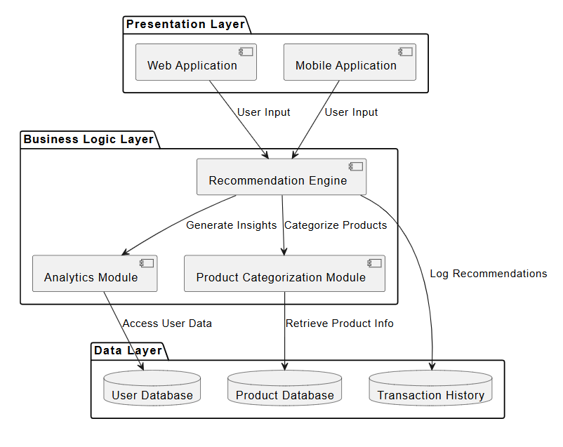
Architectural Design
The image outlines the three-layer architecture of the e-commerce platform: Presentation Layer, Business Logic Layer, and Data Layer. The Presentation Layer includes the web and mobile applications, handling user input and interactions. The Business Logic Layer manages core functionalities like the recommendation engine, analytics module, and product categorization. The Data Layer stores and retrieves user data, product information, and transaction history. This structured architecture ensures a seamless, scalable, and efficient e-commerce experience for users and sellers.

Slide 27
Algorithm Design
Step 1: Input and Initialization
Step 1.1: Start
Step 1.2: Initialize User Database:
Load user data, including user ID, preferences, and interaction history.
Step 1.3: Initialize Product Database:
Load product data, including product ID, name, brand, colour, size, and price.
Step 1.4: Initialize Recommendation Engine:
Set up collaborative filtering and content-based filtering algorithms.
Step 1.5: Set Up Analytics Module:
Configure tools for real-time data processing and visualization (e.g., Tableau, Power BI).

Slide 28
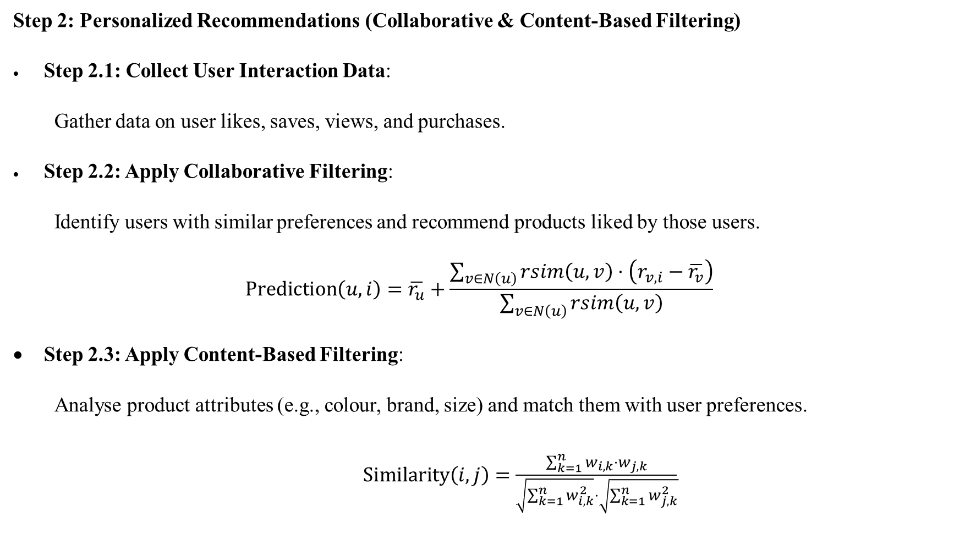
Step 2: Personalized Recommendations (Collaborative & Content-Based Filtering)
Step 2.1: Collect User Interaction Data:
Gather data on user likes, saves, views, and purchases.
Step 2.2: Apply Collaborative Filtering:
Identify users with similar preferences and recommend products liked by those users.
$$\text{Prediction}\left(u,i\right)=\overline{r_{u}}+\frac{\sum_{v∈N\left(u\right)}{rsim\left(u,v\right)}⋅\left(r_{v,i}−\overline{r_{v}}\right)}{\sum_{v∈N\left(u\right)}{rsim\left(u,v\right)}}$$
Step 2.3: Apply Content-Based Filtering:
Analyse product attributes (e.g., colour, brand, size) and match them with user preferences.
$\text{Similarity}\left(i,j\right)=\frac{\sum_{k=1}^{n}{w_{i,k}}⋅w_{j,k}}{\sqrt{\sum_{k=1}^{n}{w_{i,k}^{2}}}⋅\sqrt{\sum_{k=1}^{n}{w_{j,k}^{2}}}}$

Slide 29
Step 2.5: Display Recommendations:
Show the top recommendations to the user on the platform.
Step 3: Product Categorization (Dynamic Attribute-Based Tagging)
Step 3.1: Extract Product Attributes:
Extract attributes such as colour, brand, size, and style from the product database.
Step 3.2: Apply Dynamic Tagging:
Assign tags to products based on their attributes (e.g., "red dress," "sports shoes").
Step 3.3: Build Search Index:
Create an index of products using the assigned tags for efficient search and discovery.
Step 3.4: Handle User Queries:
Match user search queries with the indexed tags to retrieve relevant products.

Slide 30
Step 3.5: Display Results:
Show the categorized search results to the user.
Step 4: Real-Time Analytics (Data Processing & Insights Generation)
Step 4.1: Collect Data:
Gather data from user interactions, product performance, and transaction history.
Step 4.2: Preprocess Data:
Clean and structure the data for analysis (e.g., remove outliers, aggregate data).
Step 4.3: Analyse Trends:
Use statistical methods and machine learning to identify trends in customer behaviour and sales.
Step 4.4: Generate Insights:
Create reports and dashboards for sellers, highlighting key metrics such as sales trends, popular products, and customer preferences.

Slide 31
Step 4.5: Update in Real-Time:
Continuously update the analytics dashboard with real-time data to provide actionable insights.
Step 5: Transaction Processing (Order Management)
Step 5.1: Capture Transaction Data:
Record transaction details, including user ID, product ID, date, and amount.
Step 5.2: Validate Transaction:
Check for valid payment and sufficient product inventory.
Step 5.3: Update Inventory:
Reduce the product inventory count after a successful transaction.
Step 5.4: Store Transaction:
Save the transaction details in the Transaction History database.

Slide 32
Step 5.5: Confirm Transaction:
Send a confirmation message to the user and update the order status.
Step 6: User Interaction Tracking (Behavioural Data Collection)
Step 6.1: Capture User Actions:
Track user interactions such as likes, saves, views, and purchases.
Step 6.2: Store Interaction Data:
Save the interaction data in the User Database for future analysis.
Step 6.3: Update User Profile:
Update the user’s preferences and interaction history based on their actions.
Step 6.4: Refine Recommendations:
Use the updated interaction data to improve personalized recommendations.

Slide 33
Step 7: Data Verification & Security (Encryption & Compliance)
Step 7.1: Encrypt User Data:
Use encryption protocols (e.g., AES) to protect user data during storage and transmission.
Step 7.2: Implement Secure Authentication:
Use OAuth or JWT for secure user authentication and session management.
Step 7.3: Ensure Compliance:
Adhere to data privacy regulations such as GDPR and CCPA.
Step 7.4: Conduct Security Audits:
Regularly audit the system for vulnerabilities and ensure data integrity.
Step 8: Stop
Step 8.1: Stop when all processes are complete:
Personalized recommendations are displayed.

Slide 34
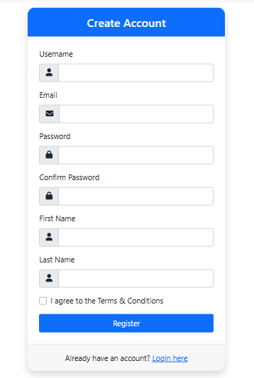
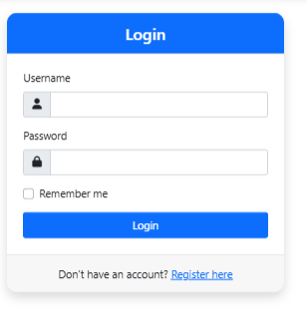
Output Screens
Register
Login

Slide 35
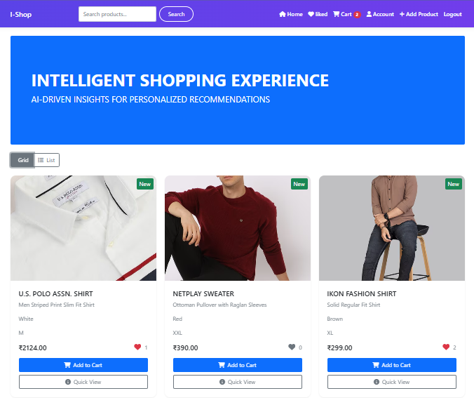
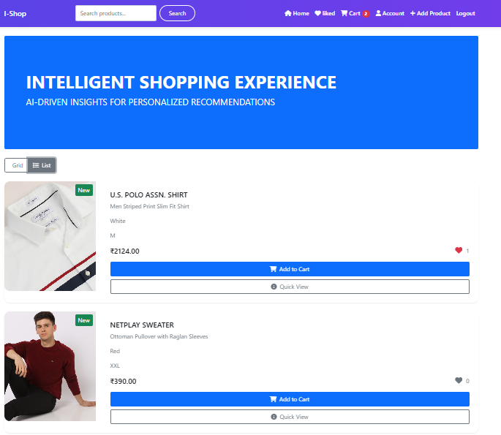
Home Screen
Grid View
Home screen
List view

Slide 36
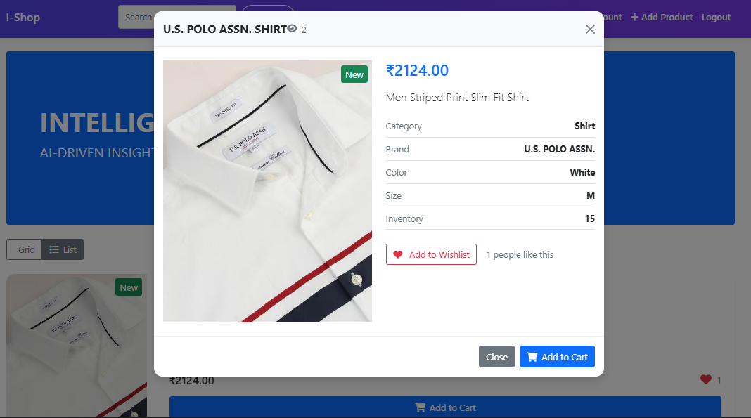
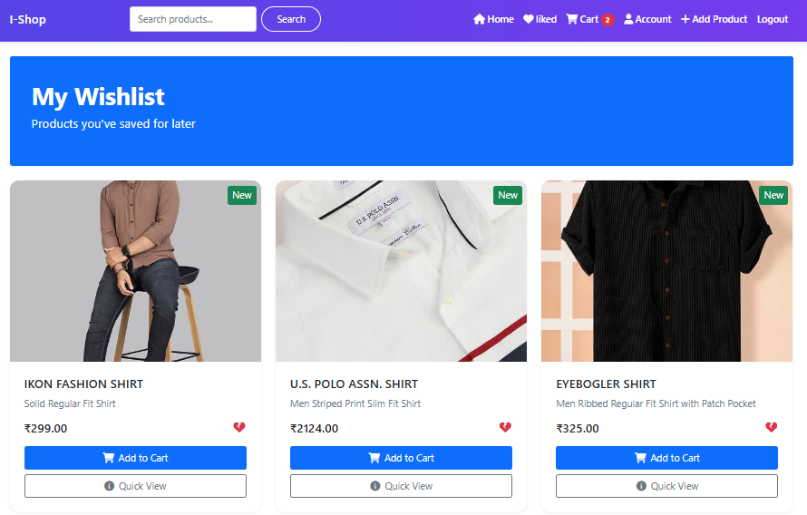
Quick View
Wishlist

Slide 37
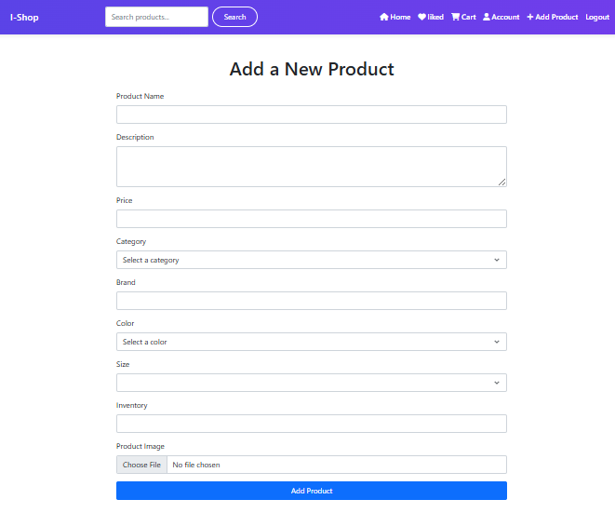
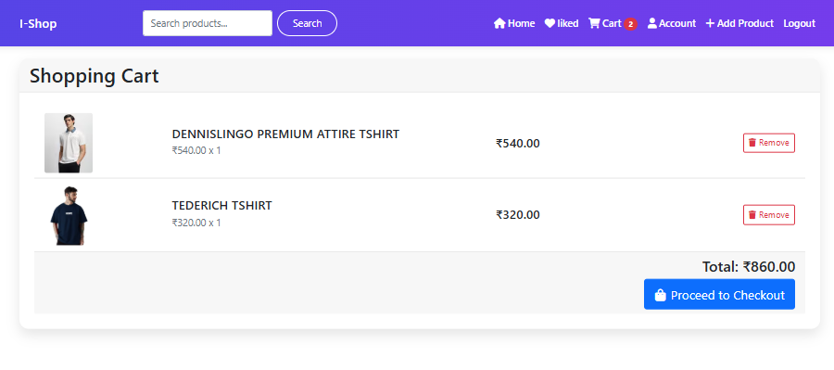
Add Product
Cart

Slide 38
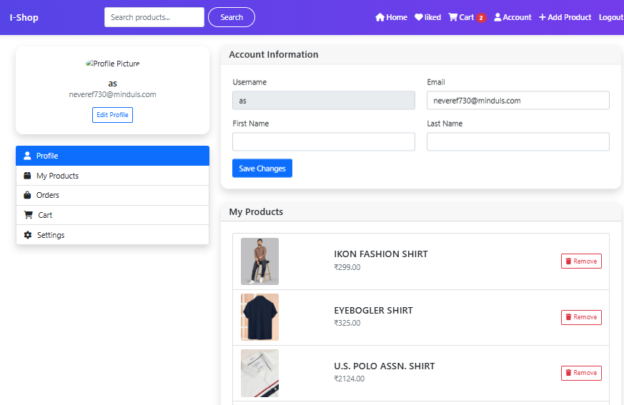
User Account and Product Sold Page

Slide 39
Conclusion
The integration of AI and ML transforms the retail experience through personalized recommendations, dynamic product categorization, and real-time analytics.
A user-centric approach enhances engagement, while data-driven insights empower sellers to make informed decisions.
This intelligent ecosystem creates a seamless shopping experience, driving customer satisfaction and business growth.
Efficient search and dynamic filtering improve product discoverability, enhancing user convenience.
Real-time analytics empowers sellers with actionable insights to optimize product strategies.
Robust security and privacy measures ensure user trust and compliance with data protection regulations.

Slide 40
Thank You

